Slide 1
PROJECT 4 – TEAM 7
Soumya Swain
Suad Godax
Isabel Angwah
Heidi Chang
Diego Martorell
Notes:
Heidi
Hello everyone, we are team 7. here are our team members …….

Slide 2

Problem Statement
The aim of our project is to uncover patterns that would let us know if a loan will be paid or it will have to be written off based on data from a company called Loan Tap.
We will examine the relationship between the loan amount, term of the loan, installment amounts and also characteristics of the person borrowing the money such as annual income and employment length.
Notes:
Heidi
we are trying to develop a predictive model that accurately identifies if the loan will be paid off or will default by looking at different attributes including dti ratio, a person’s annual income, loan amount and number of open accounts, etc….

Slide 3


Data Description
Source
Size of Data
97,728 KB
Dataset of credits offered to individuals and businesses by the company Loan Tap
Description
Notes:
Heidi
we got our data from Kaggle. the data is from from Loan Tap. Loan Tap is an online platform committed to delivering customized loan products to millennials. The dataset is mainly focusing on personal loan. The loan amount from the data set is from 500 to 40,000 and from year 2007 to 2016. It includes 27 columns and approximately 400k rows. now i will pass on to Diego to talk about our process.

Slide 4


Our process
Original Dataset
Data Cleaning
Store Data in SQLite format
Create dummies for Categorical Columns
-Remove NA’s
-Remove columns not convenient for our models
-Remove original Categorical Columns
Split Data
Scale Data
Create models and visuals
Logistic Regression Model
Decision Tree Model
Random Forest Classifier Model
Neural Network Deep Learning Model
XGboost
-Training and Testing Datasets
Notes:
Diego
To prepare our original dataset for this project, we followed the process outlined on the screen. We did some data cleaning, removing na’s and columns not convenient for our models. We stored the clean dataset in sqlite format. Then, we created dummies for the categorical columns and we deleted these categorical columns. Next step was splitting the data into training and testing sets. Then, we scaled the data and we proceeded to create our models.

Slide 5
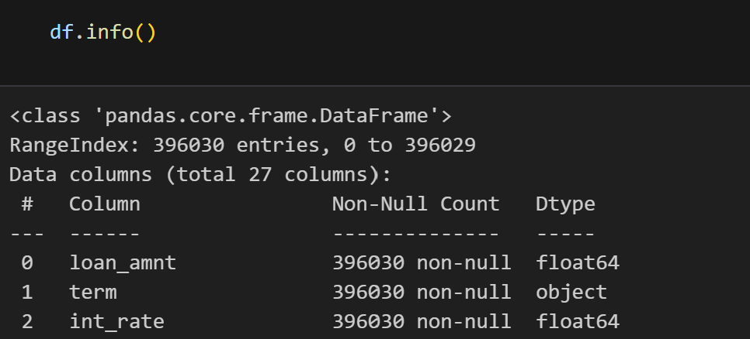
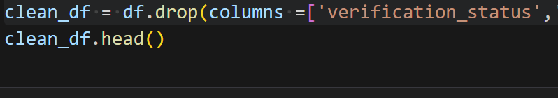
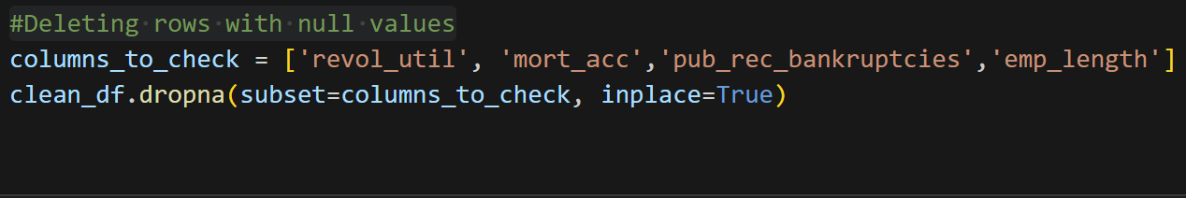
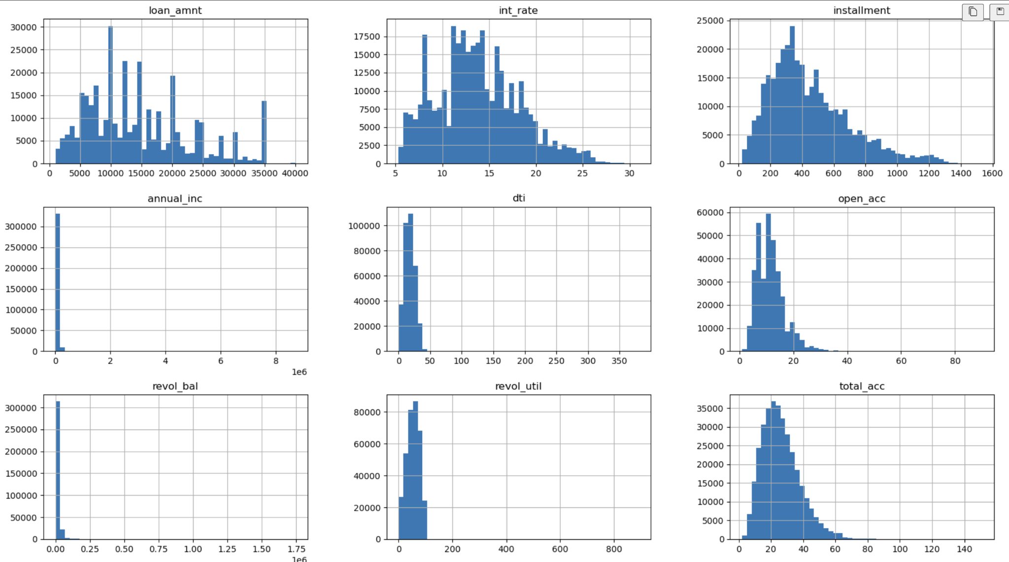
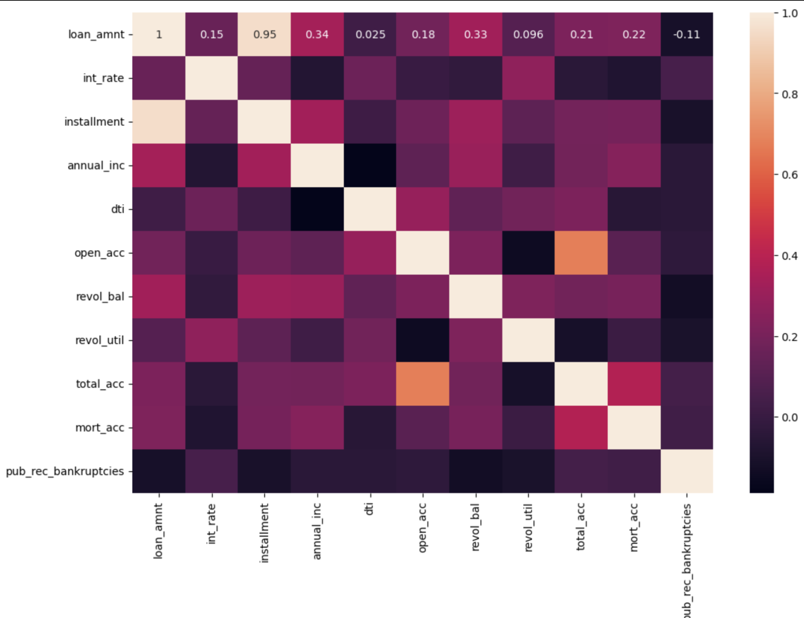
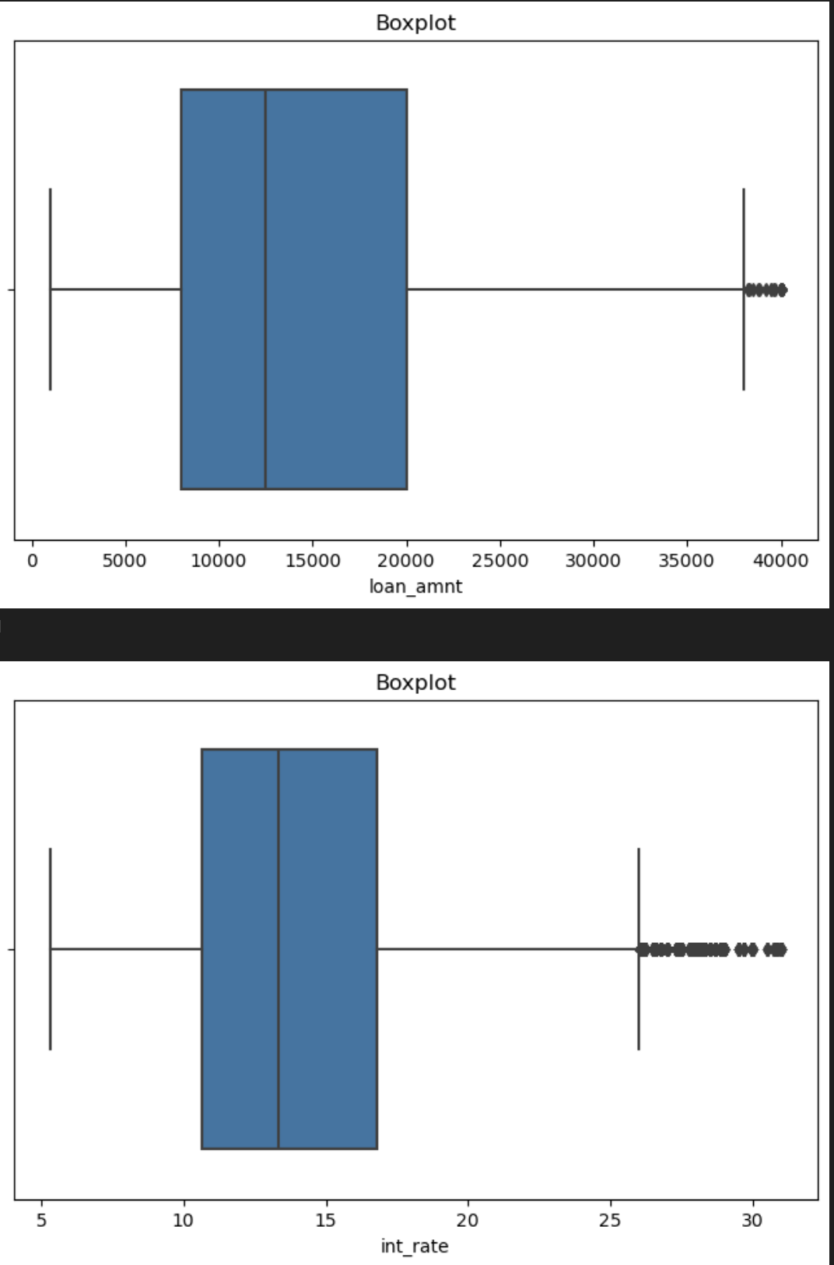
Exploratory Data Analysis
Identify data types | Drop non relevant columns | Delete rows with null values
Distribution of numeric data | Determine and remove correlated features | Remove outliers for numeric features
Notes:
Soumya

Slide 6
Modelling Experiment Design
Statistic Technique suitable for Binary Classification problems (Loan paid or written off)
Computationally efficient and can handle large datasets
It performs well since there is a clear separation between healthy and high-risk loans based on the available features
Accurate predictions
Logistic Regression Model
Decision Trees work well with large datasets and are relatively fast to train
Decision Trees are easy to interpret and understand
Can handle non-linear relationships between features and the target variable
Decision Tree Model
Typically provide high accuracy in predicting loan outcomes
Robust to outliers and noise in the data
Can provide insights into feature importance, helping identify most relevant factors influencing loan decisions
Random Forest Classifier Model
Notes:
Isabel

Slide 7
Modelling Experiment Design
Excel at capturing complex relationships in data
Can scale well with increasing data size and complexity
State of the art performance in machine learning tasks
Neural Network Deep Learning Model
High performance and efficiency in handling large datasets.
Produces accurate predictions
Incorporates regularization techniques to prevent overfitting.
XGBoost
Notes:
Isabel

Slide 8
Model Evaluation
Logistic Regression | Decision Tree | Random Forest Classifier | Neural Network Deep Learning | ***XGBoost
accuracy score: 0.804 precision: 0 - 0.55 1 - 0.81 recall: 0 - 0.06 1 - 0.99 | accuracy score: 0.710 precision: 0 - 0.27 1 - 0.82 recall: 0 - 0.29 1 - 0.80 | class_weight = balanced accuracy score: 0803 precision: 0 - 0.53 1 - 0.81 recall: 0 - 0.07 1 - 0.99 | Accuracy score: 0.80 Precision: 0 - 0.54 1 - 0.81 Recall: 0 - 0.10 1 - 0.98 | Train with class weight accuracy score: 0803 precision: 0 - 0.53 1 - 0.81 recall: 0 - 0.10 1 - 0.98
class_weight = balanced accuracy score: 0.646 precision: 0 - 0.31 1 - 0.89 recall: 0 - 0.67 1 - 0.64 | class_weight = balanced accuracy score: 0.71 precision: 0 - 0.27 1 - 0.82 recall: 0 - 0.28 1 - 0.82 |  |  | only on 10 important features based on random forest classifier accuracy score: 0803 precision: 0 - 0.52 1 - 0.81 recall: 0 - 0.08 1 - 0.98
Notes:
Suad

Slide 9
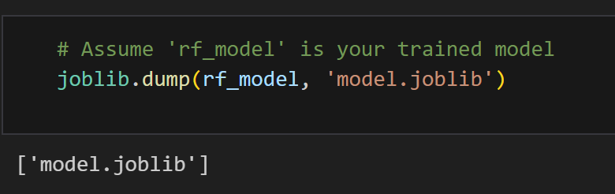
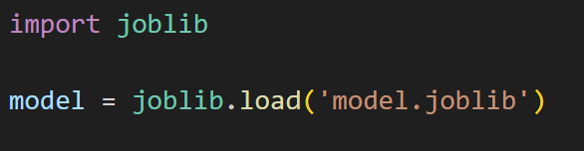
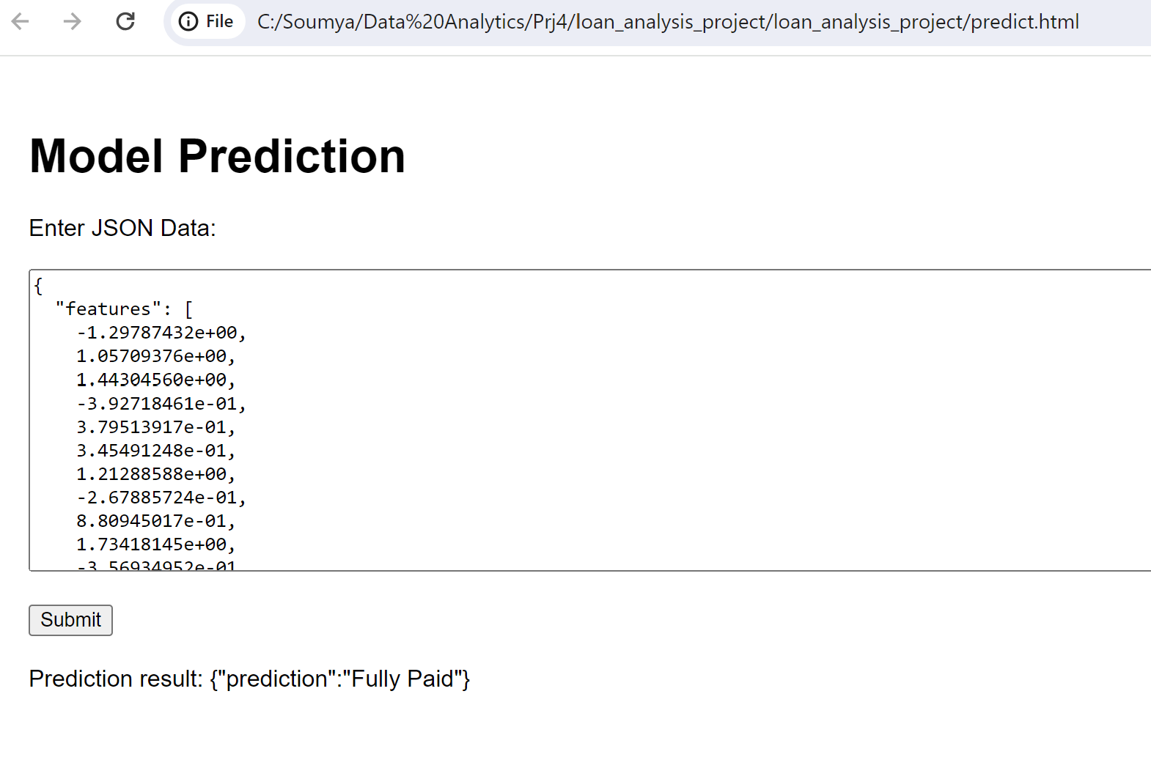
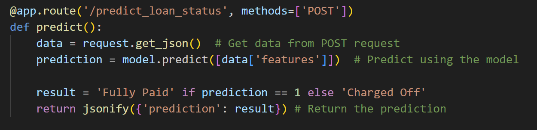
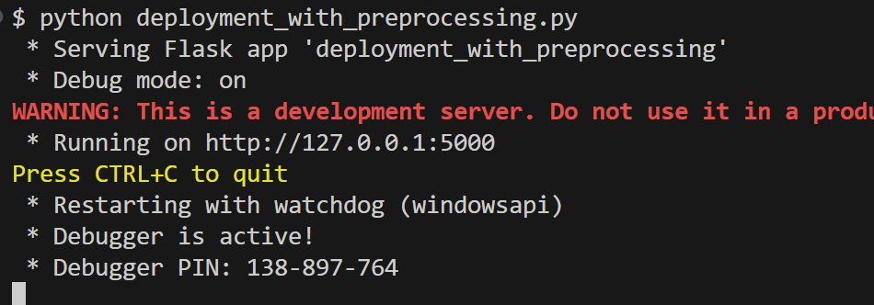
Model Deployment
Save trained model
Deploy ML model as a flask app
HTML/javascript web app to access the API
Notes:
Soumya

Slide 10
Limitations and Assumptions
the data is imbalance - Fully paid (80%) has a lot more data compared to charged off (20%).
the data is from 2007 to 2016.
Our models are only applicable to loan tap clients.
Our dataset is comprised of loans of less than 40K.
Notes:
Heidi
some of the limitations of our data includes the following: as mentioned earlier, our dataset is focusing on only personal loan and it is from Loan Tap. The loan amount ranges from $500 to 40,000. also, majority of the loan were being paid off and only 20% is not being paid. The dataset may be out of date as the data is from 2007 to 2016. now i will pass on to Diego to talk about considerations for future and key learning points.

Slide 11
Considerations for future
Explore if including some of the columns not used from the original dataset our models can improve and have more accurate results.
Try other models to train the dataset and obtain a higher accuracy.
Obtain more information about the people who obtained these loans. Such as age, educational level, credit score and other relevant information not present in the data
Notes:
Diego
Looking ahead, there are several considerations for improving our model. First, we initially excluded certain columns from our dataset, such as verification status (which indicates whether the borrower’s income was verified by Loantap) and employment title. Including these columns could potentially enhance our model's performance.
Additionally, exploring a broader range of models might yield higher accuracy. We used 5 models for our project but there are many more we didn’t explore.
Finally, our dataset was missing valuable information about borrowers, such as age, credit score, and educational level. Incorporating these features could provide a more comprehensive view of the borrowers and likely lead to better model performance.

Slide 12
Key Learnings
Our logistic regression model has an accuracy greater than 80% which means our model is performing well in making correct predictions.
Our logistic regression model (Class weight: balanced) had a lower accuracy which means our loan dataset was probably not highly imbalanced and applying that class weight might had potentially introduced bias, affecting our model.
Our decision tree model has lower accuracy than our logistic regression model which might be due to the fact that decision trees struggle to capture complex relationships in the data compared to the first model mentioned.
Our random forest classifier model has similar accuracy than our logistic regression model. This can suggest that he decision boundaries learned by the Random Forest Classifier are as effective as the linear boundaries learned by the Logistic Regression model.
Our XGBoost and logistic regression model has the same accuracy. Therefore, considering XGBoost is a more complex and powerful algorithm compared to Logistic Regression. The fact that both models achieve the same accuracy implies that the additional complexity of XGBoost may not be necessary for this specific dataset and task
Notes:
Diego
We were able to learn a lot working on this project. First of all, let’s discuss our Logistic Regression model. This model has achieved an accuracy greater than 80%, which indicates that it is performing exceptionally well in making correct predictions. It has proven to be a strong candidate for our dataset but it’s worth noting that when we applied class weights to balance the data, the accuracy dropped. This suggests that our dataset wasn’t significantly imbalanced, and adding class weights might have inadvertently introduced bias.
Next, we examined the Decision Tree model. While Decision Trees are versatile and easy to interpret, they tend to struggle with capturing complex relationships within the data. This limitation was evident in our case, as the Decision Tree model delivered lower accuracy compared to our Logistic Regression model.
Moving on to the Random Forest Classifier, we found that its accuracy is comparable to that of the Logistic Regression model. The similar performance between Random Forests and Logistic Regression indicates that the more complex decision boundaries learned by the Random Forest are on par with the linear boundaries identified by the Logistic Regression model.
Finally, let’s consider the XGBoost model. Despite being a more advanced and complex algorithm, XGBoost achieved the same accuracy as our Logistic Regression model. This outcome implies that, for our dataset, the additional complexity and power of XGBoost may not be necessary, as the simpler Logistic Regression model is performing just as well.

